Slide 1
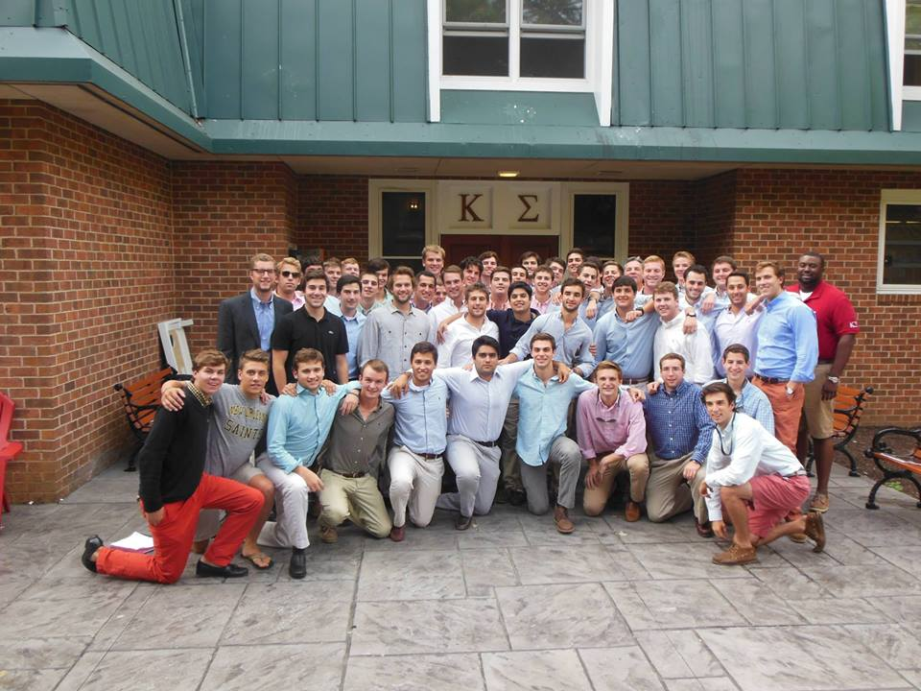
Kappa Sigma Accreditation
Rand Monaghan, President

Slide 2
Organizational Development

Slide 3
Recommendations from 2012-2013
Needs to begin looking at creating a long-term plan that lays out clear expectations and goals for members to aspire to

Slide 4
Officer Transition
Formal workshop to get new EC up to speed
Moved 2014 elections earlier in the semester to improve transition

Slide 5
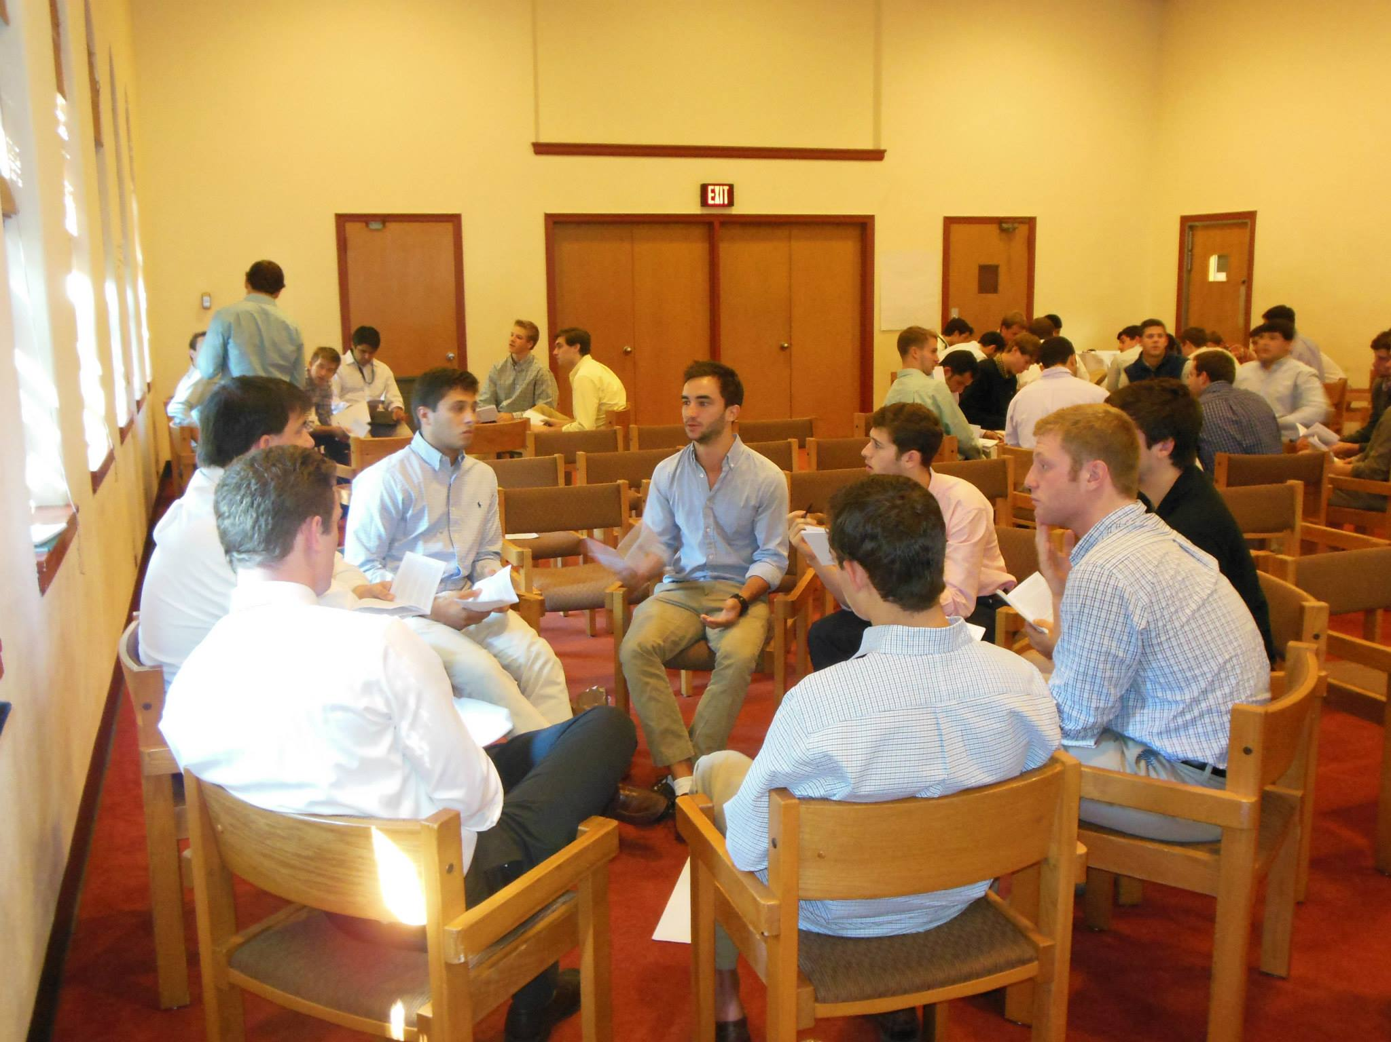
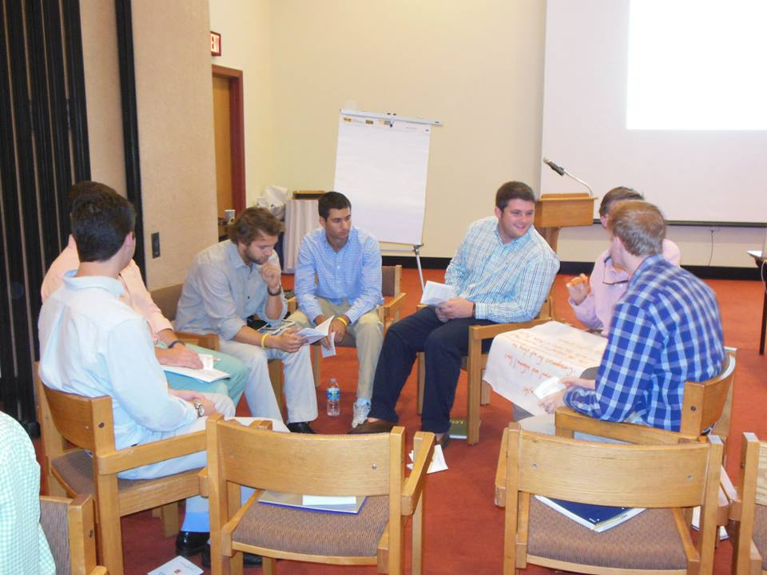
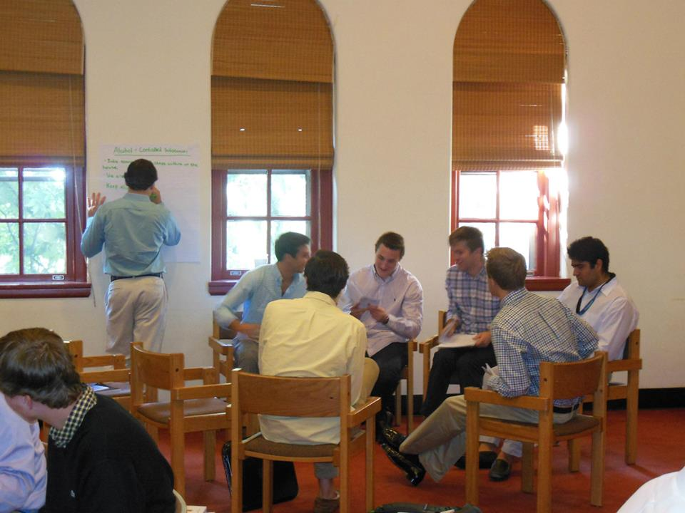
Sub-Committees

Slide 6
Shared Responsibilities
Nationals Retreat
Spread out the responsibility throughout the Chapter
Twelve sub-committees

Slide 7
Looking Forward
Continue sub-committees
Increase responsibility of each member of the Chapter

Slide 8
Community Development
Jonathan Mamon, Community Service Chairman
Ryan Staffen, Communications Chairman

Slide 9
Community Service & Philanthropic Goals for 2013-2014:
Start Early!
Host a philanthropy event in the Fall of 2013
Establish a meaningful perpetual service initiative

Slide 10
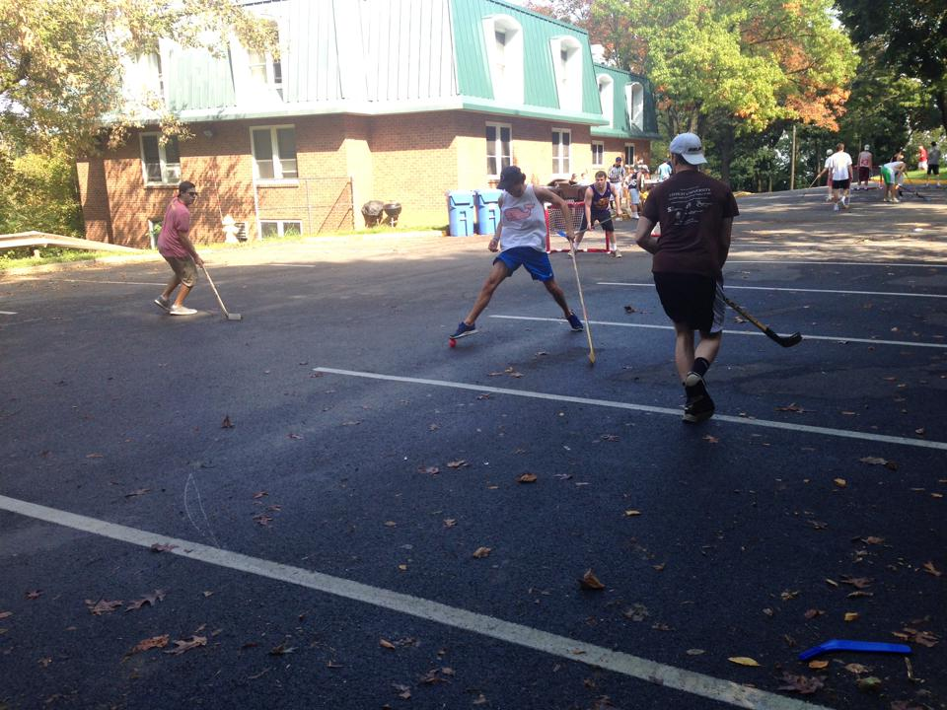
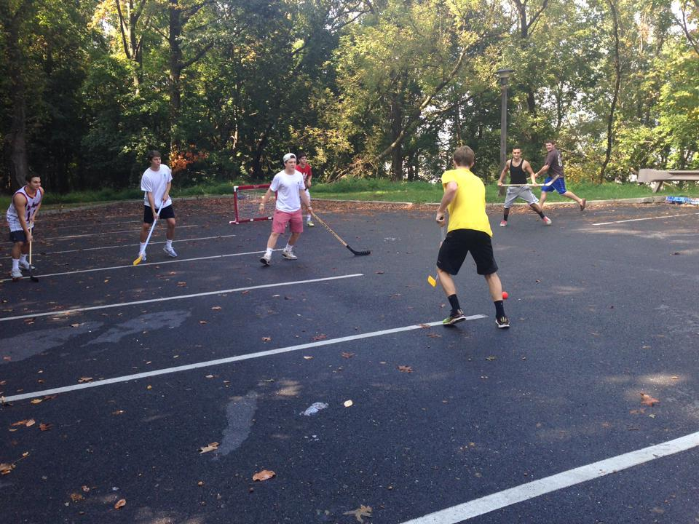

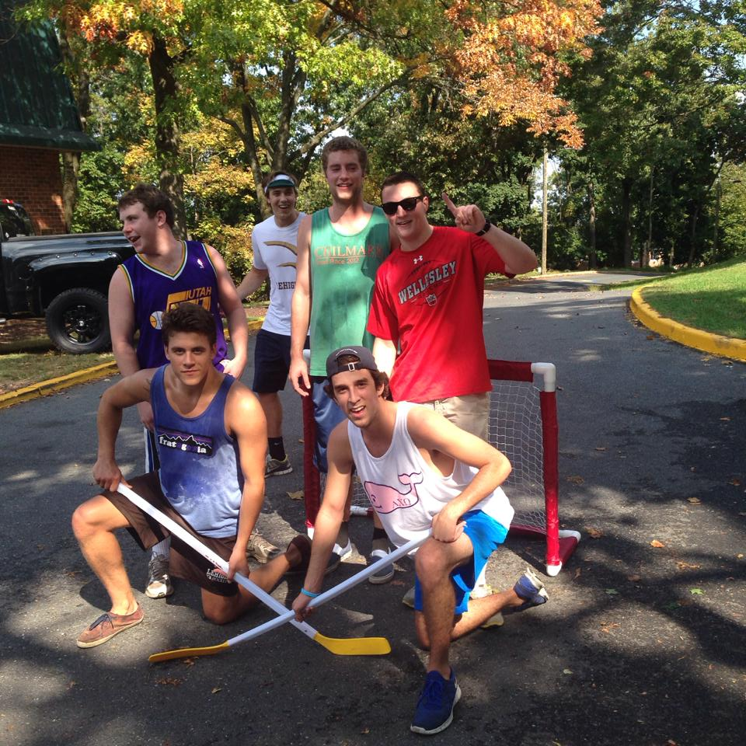
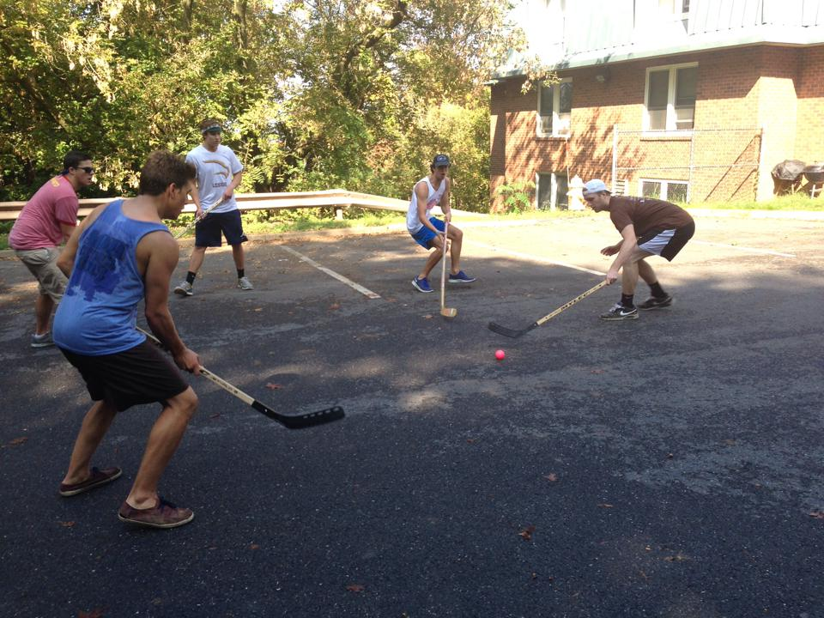
Kappa Sigma Day of Service: Kappa Slappa

Slide 11
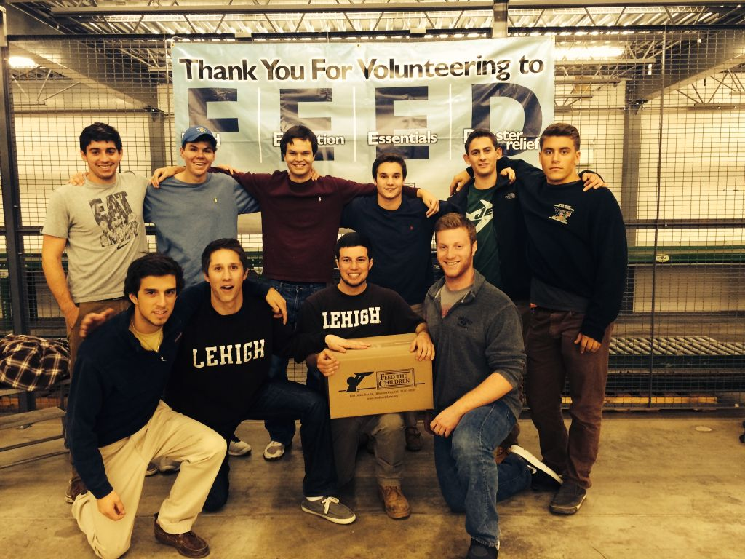
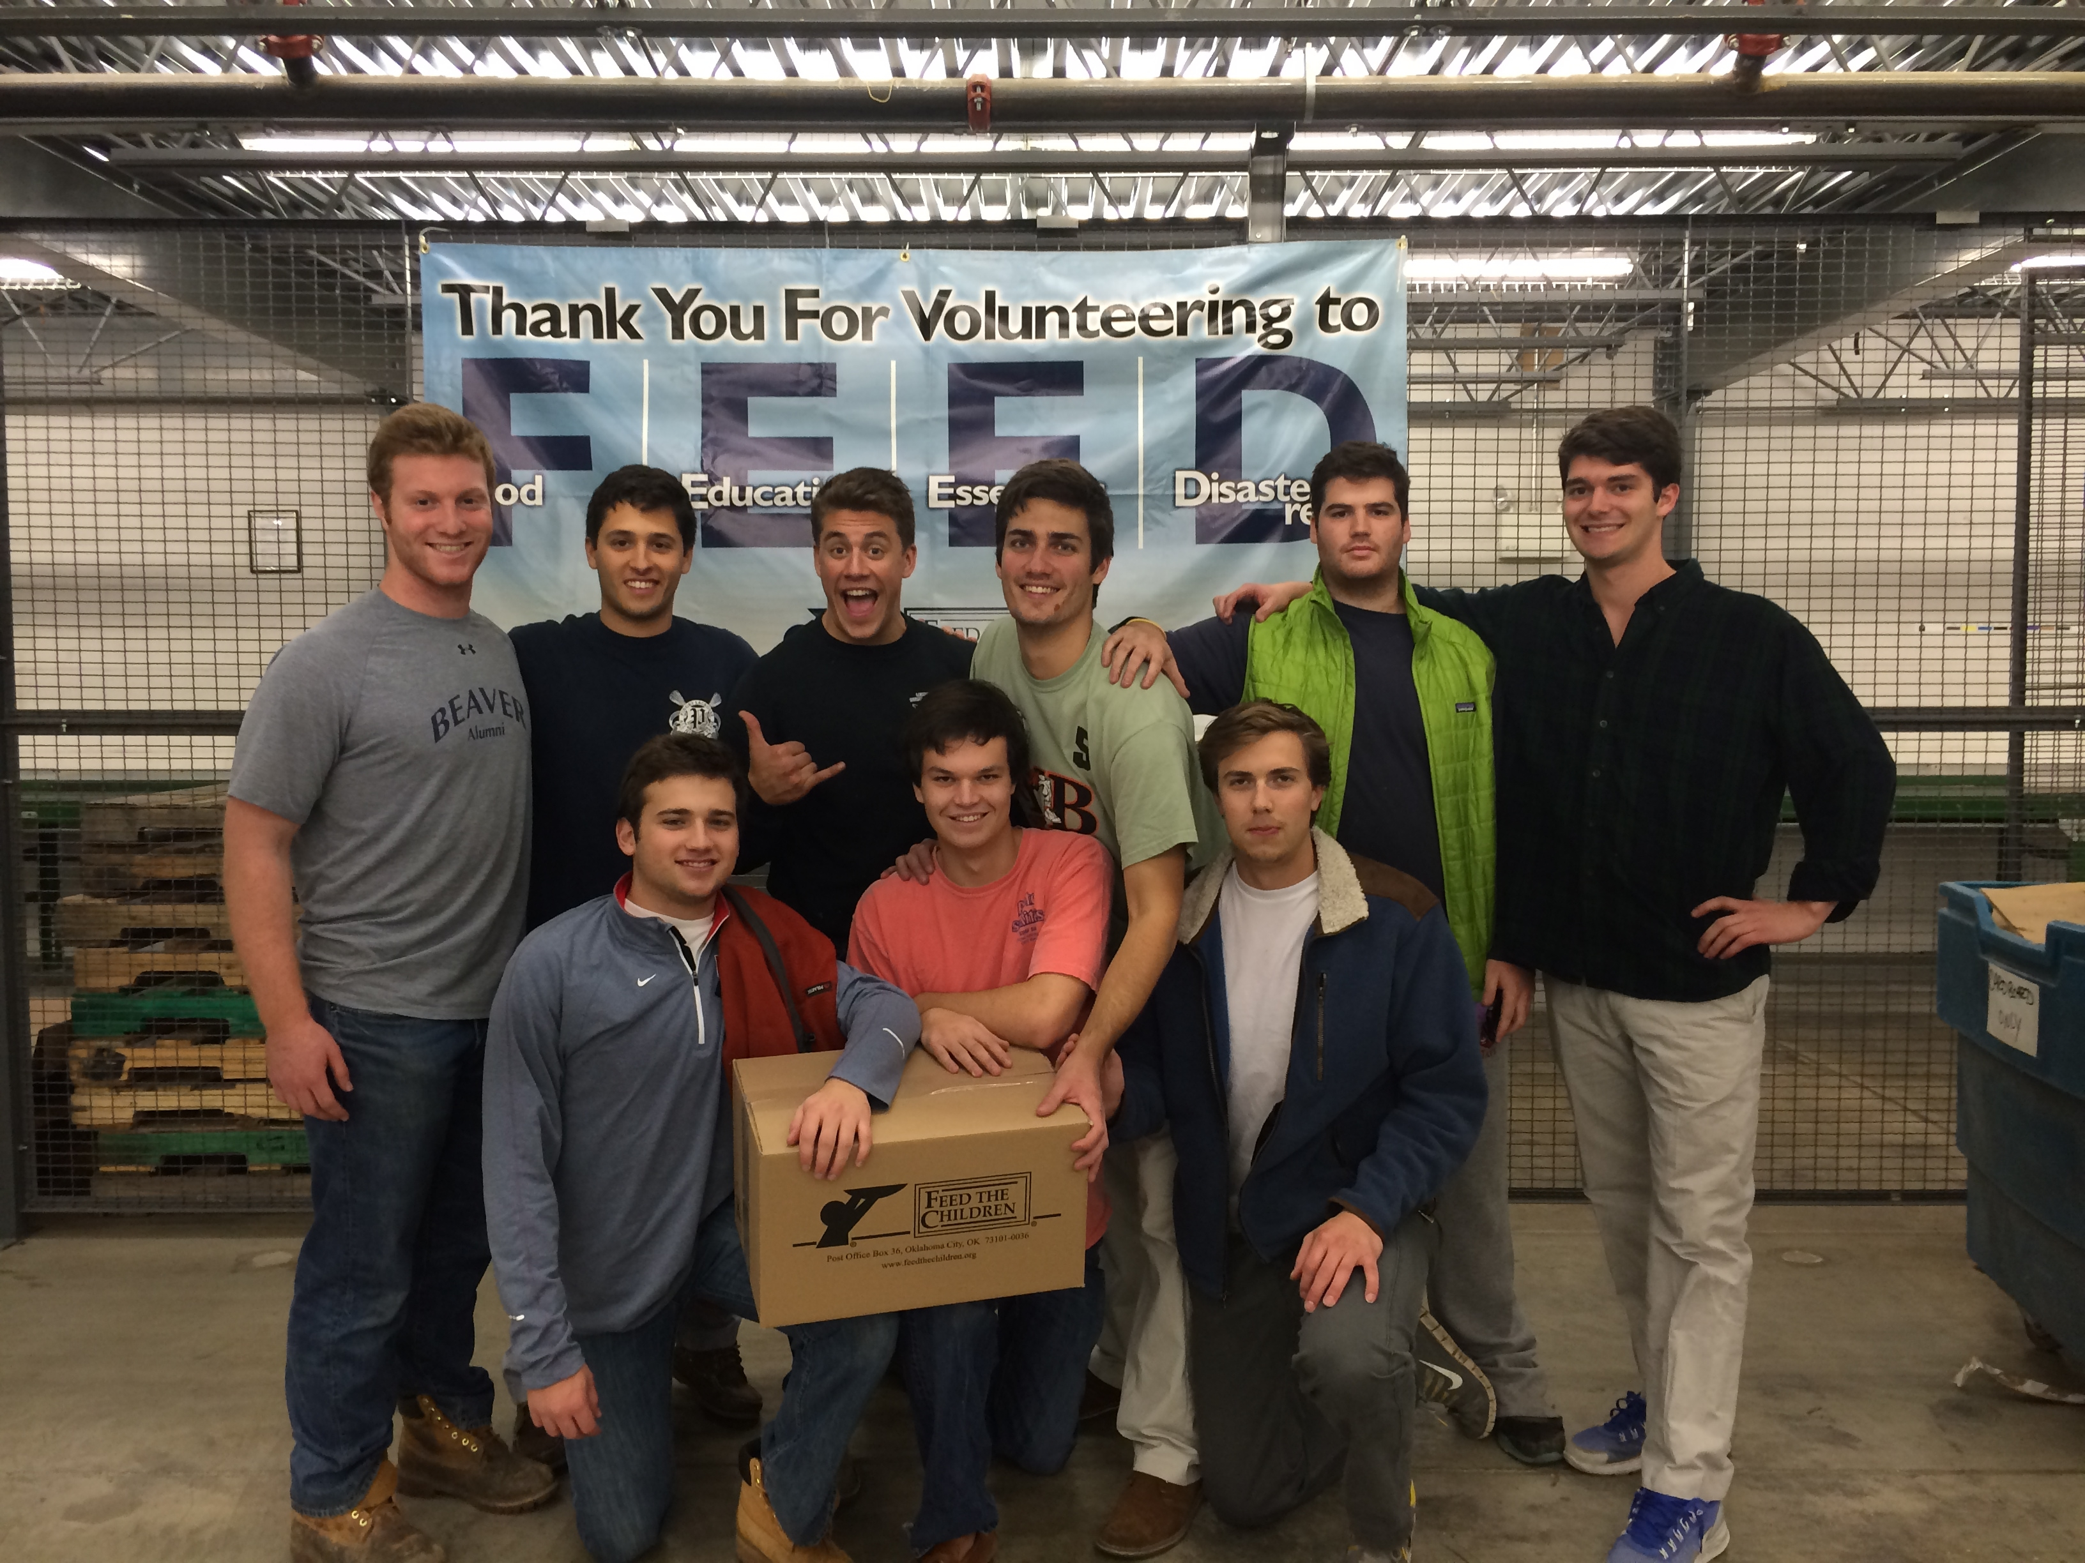
Perpetual Service for 2013-2014: Feed The Children
Biweekly visits since October
Assembled pallets of Food, Toiletries, and essential items
Impact: 14,000+ Families in the United States

Slide 12
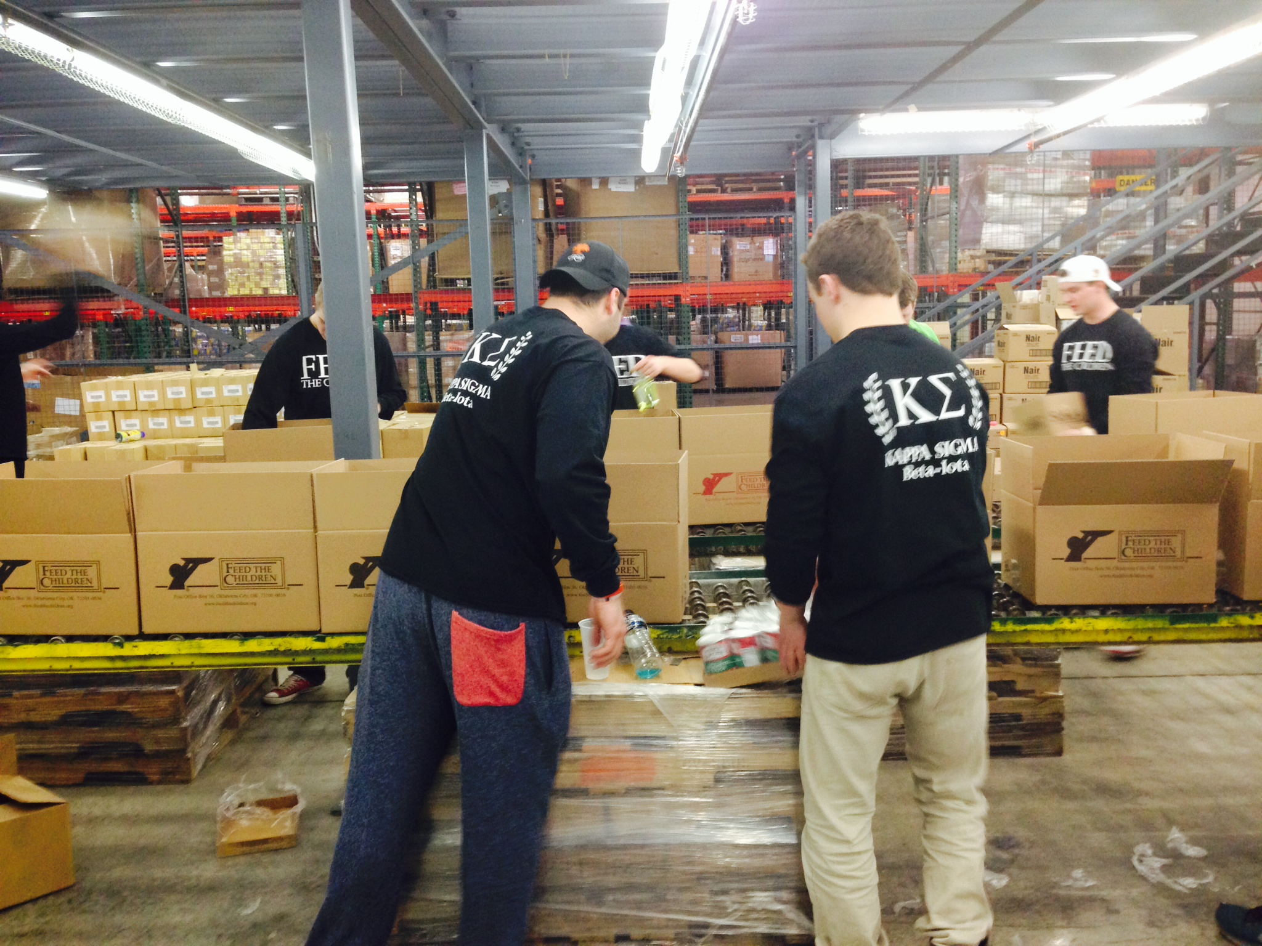
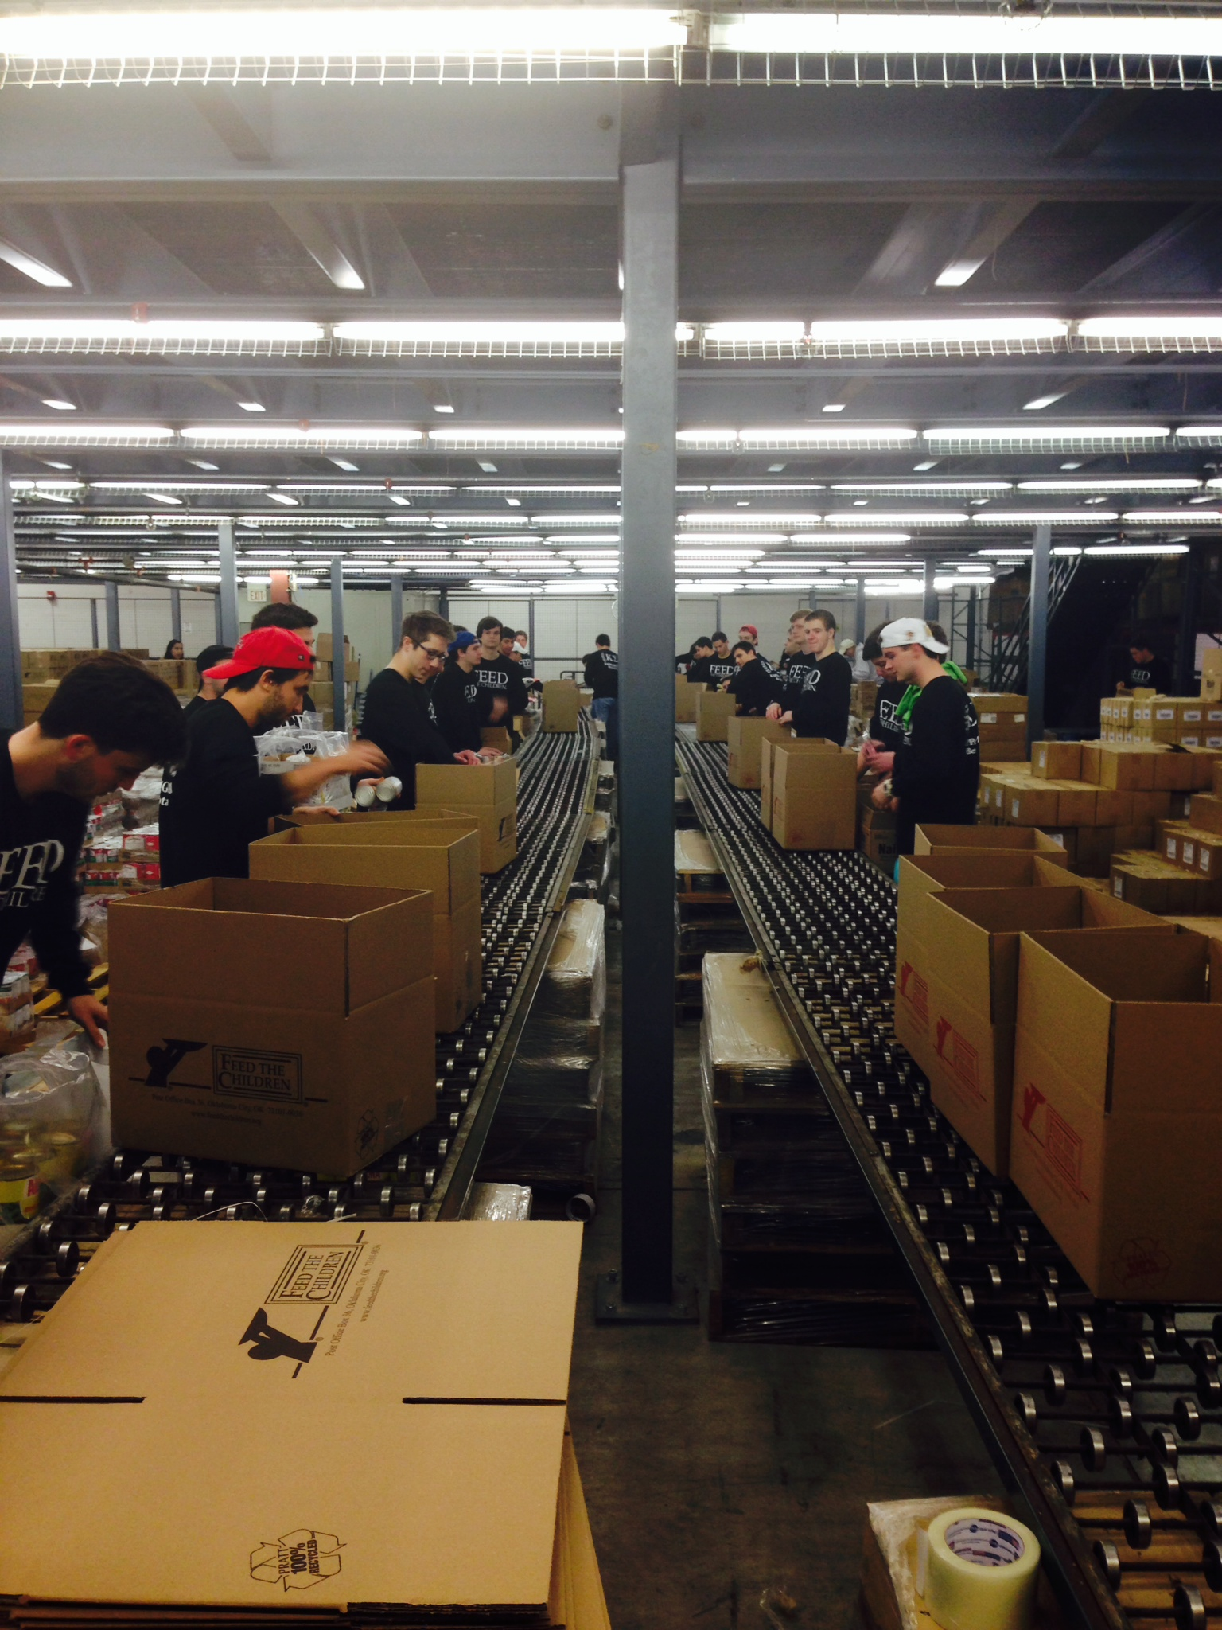
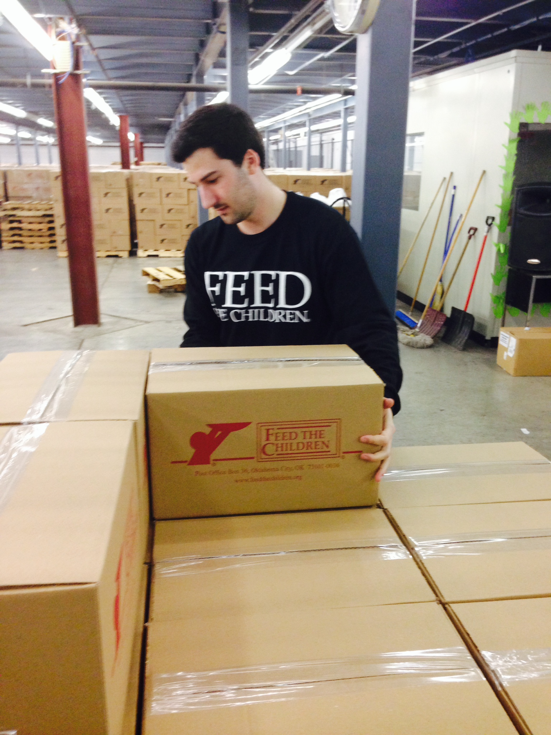
Feed The Children Marathon: March 22nd, 2014

Slide 13
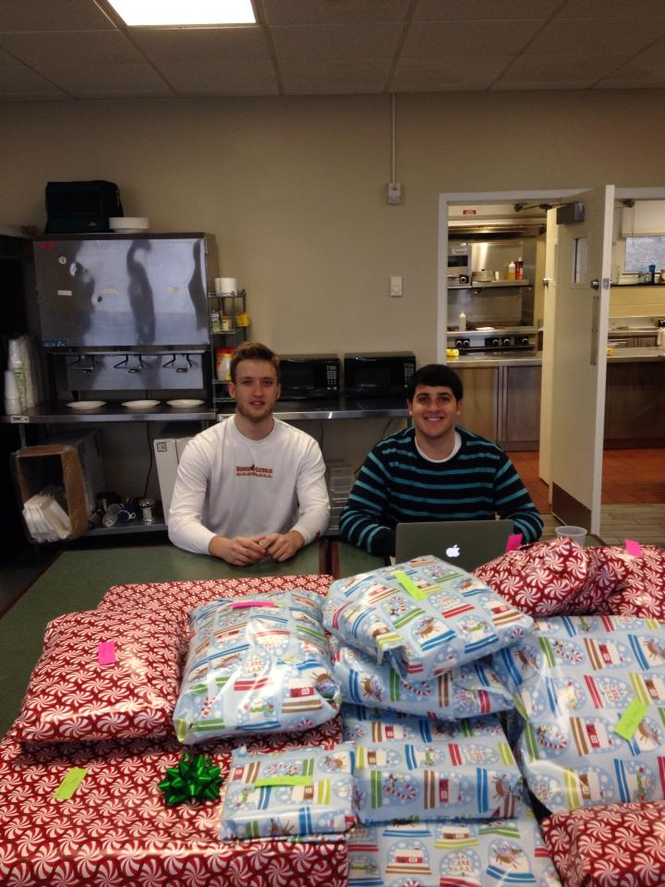
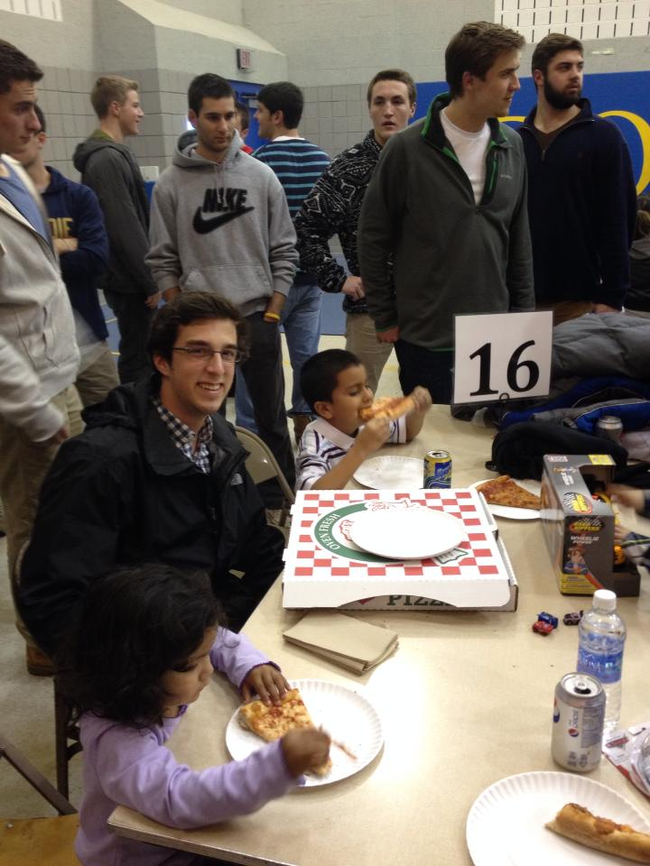
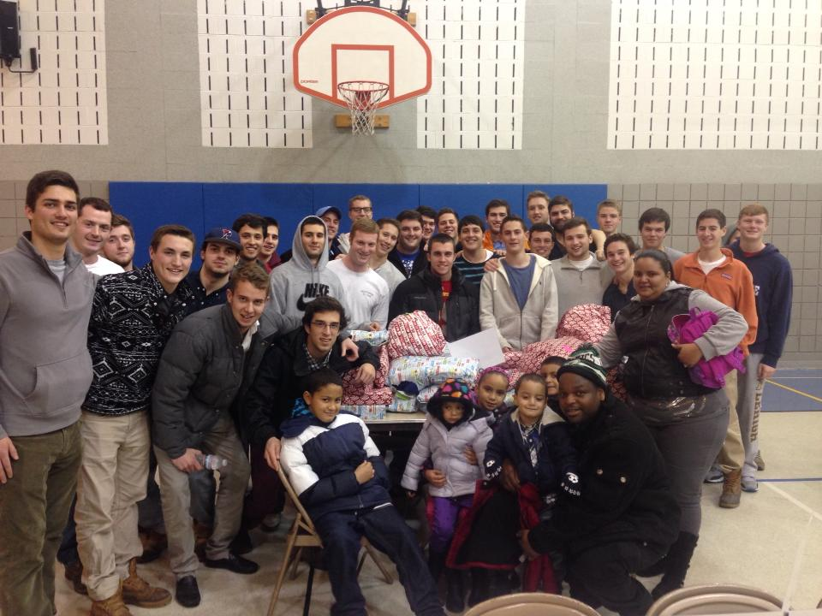
Adopt-a-Family & Shop with a Lehigh Cop

Slide 14
Poverty Simulation
Participated February 19th, 2014
Over 50 Brothers and Pledges in attendance
Beneficial toward our mission at FTC

Slide 15
Polar Bear Plunge: January 6th, 2014

Slide 16
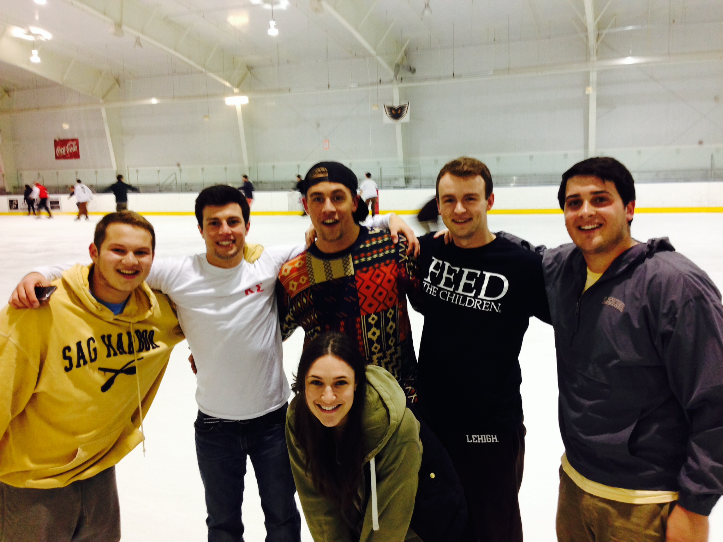

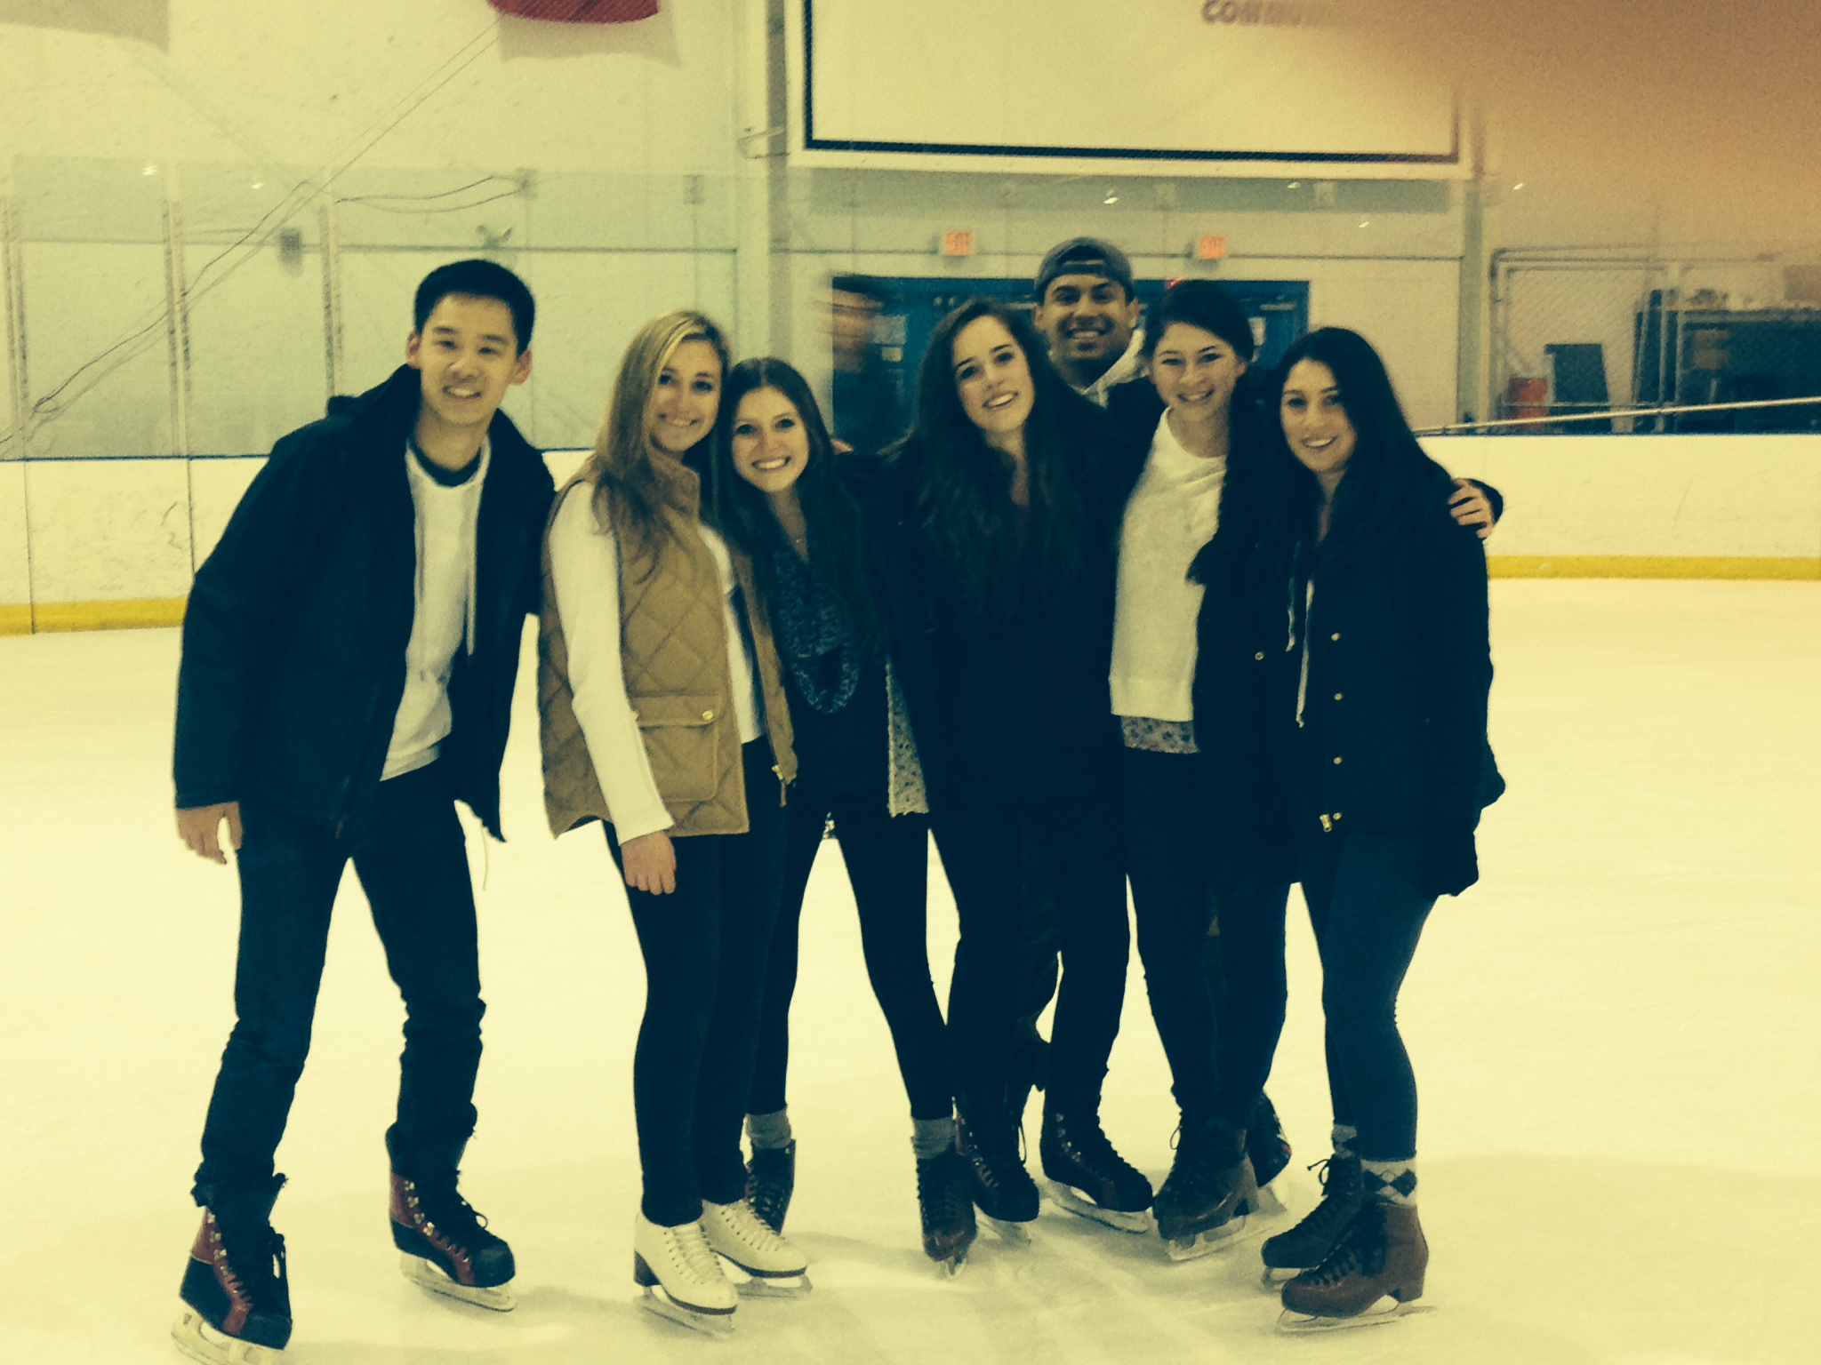
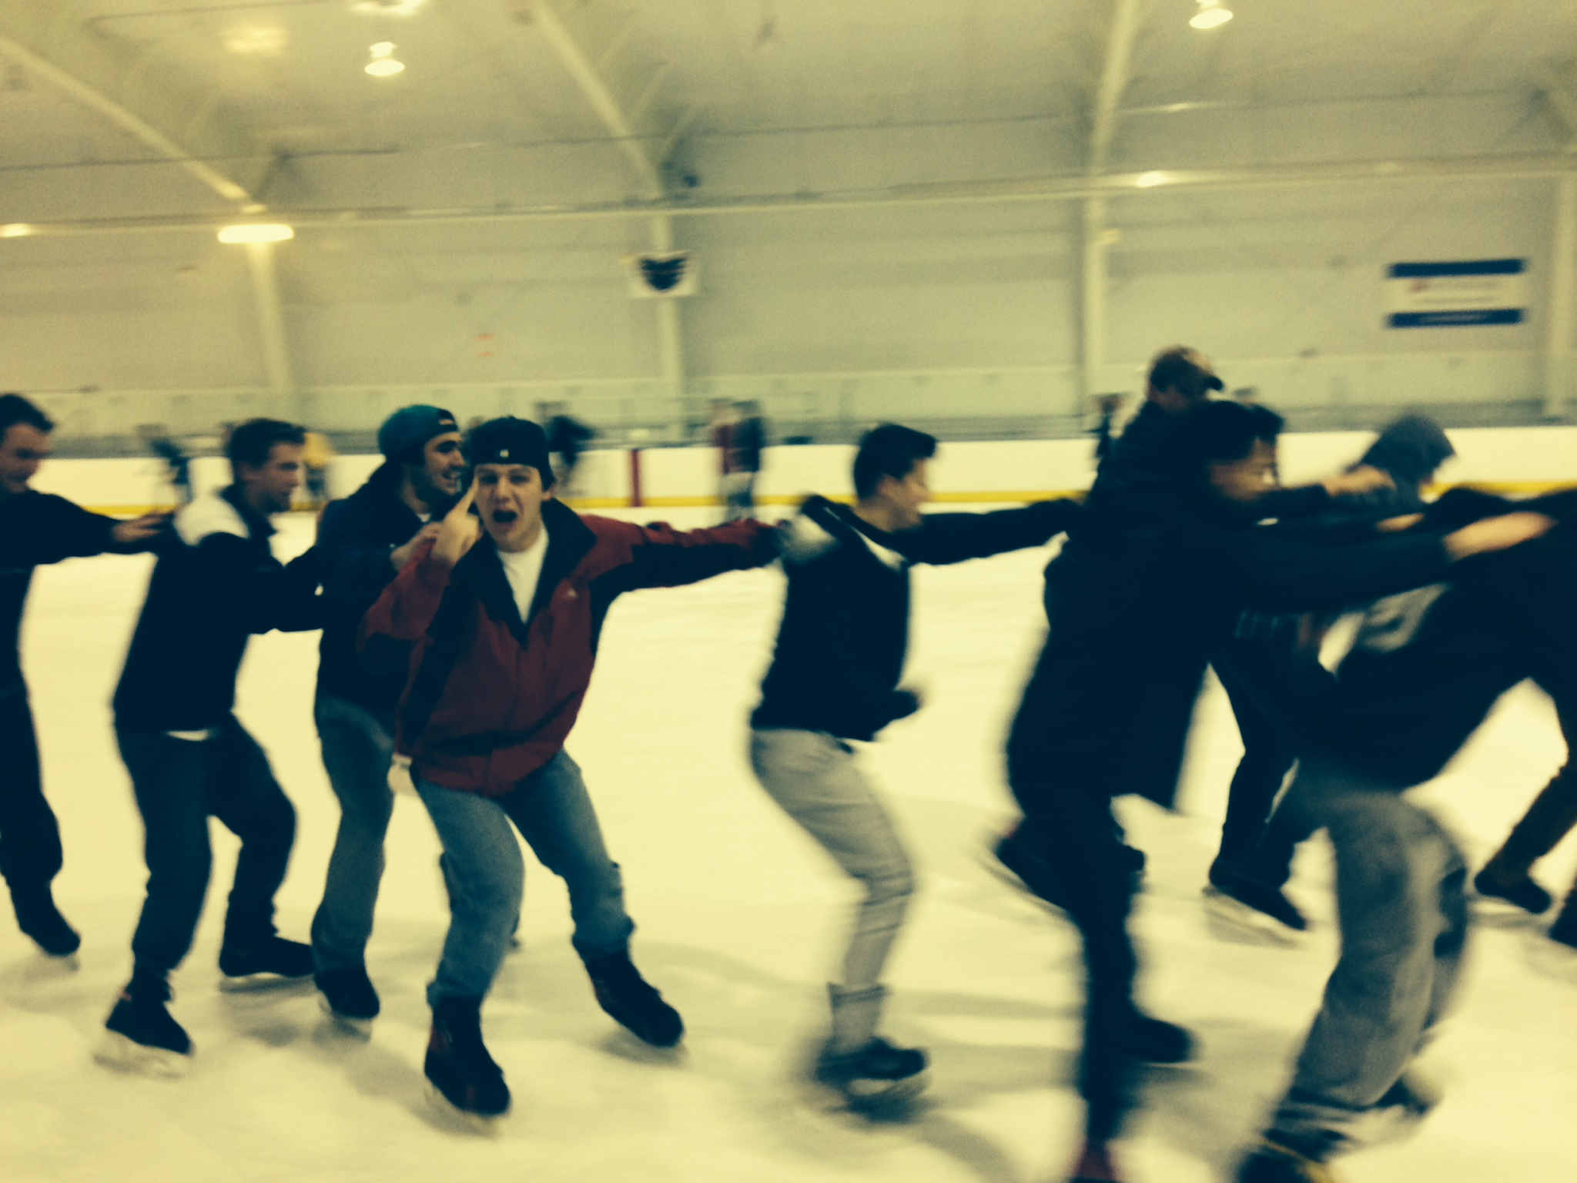
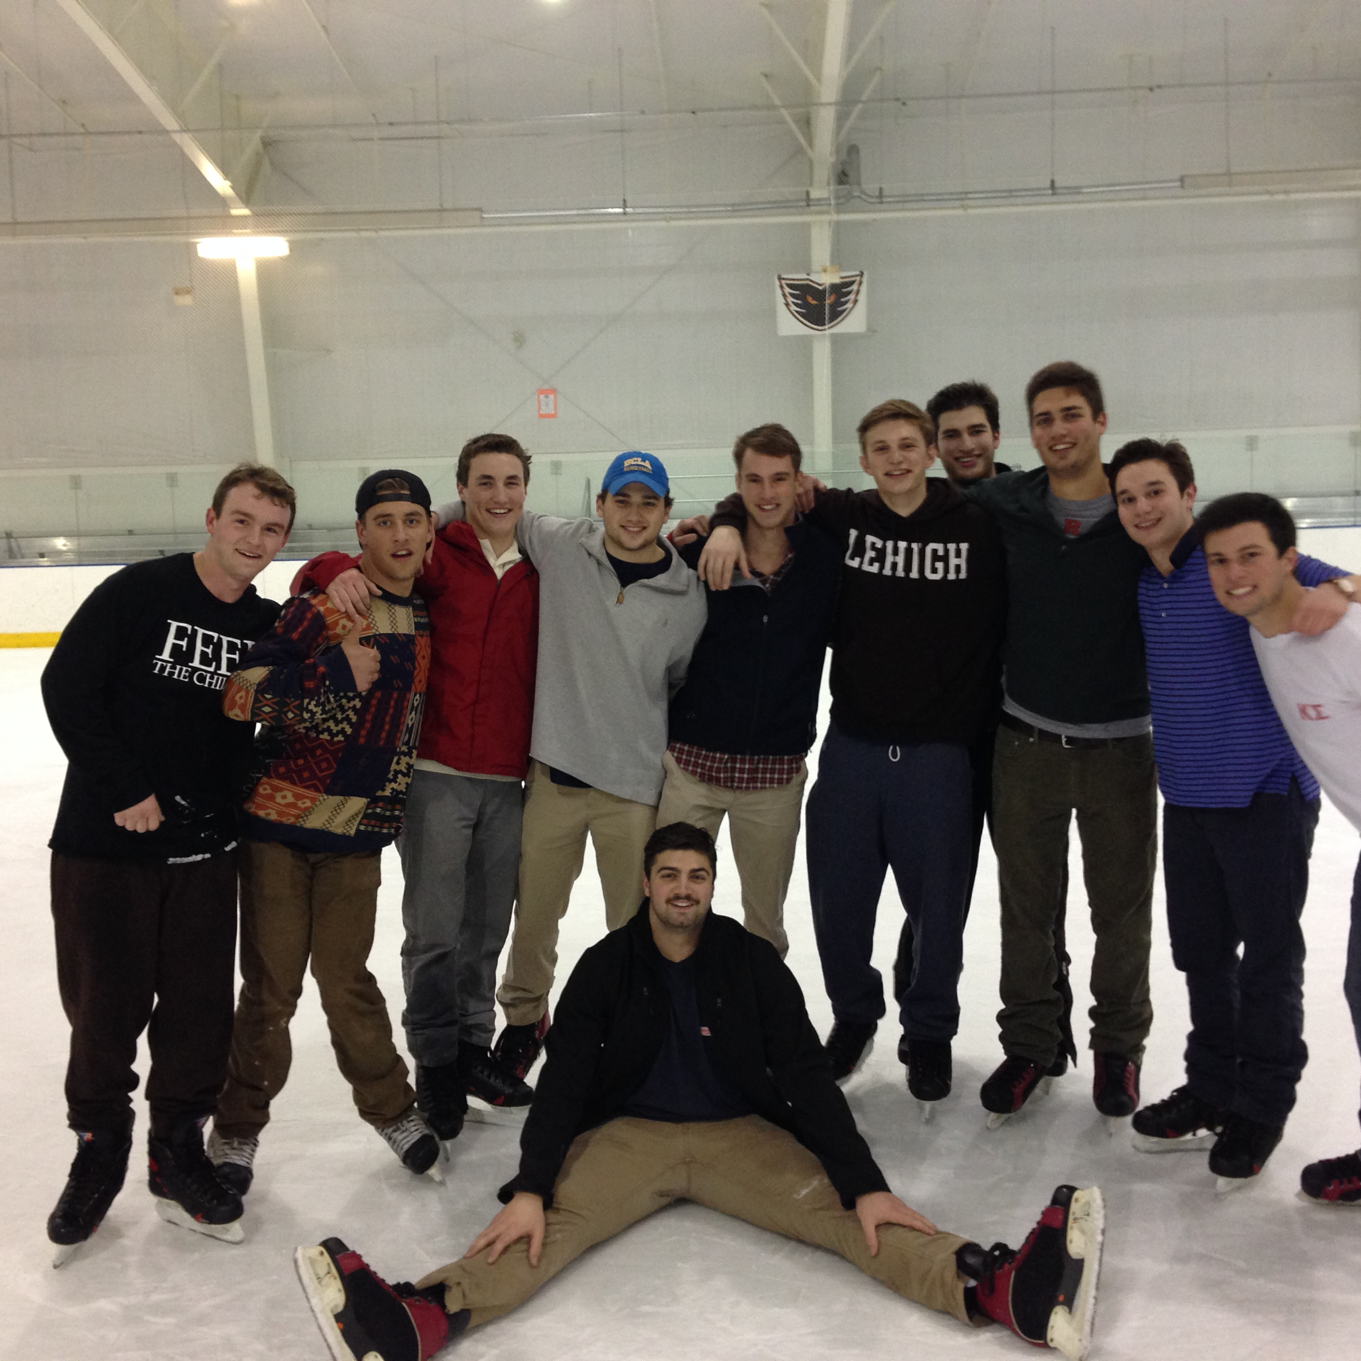
Open Skate: March 29th, 2014

Slide 17
Campout For Our Troops: April 9th, 2014
April 9th, 2014

Slide 18
Father/Son Golf Fundraiser
April 12th 2014

Slide 19
Kappa Sigma Beta-Iota Chapter Facebook Page Ryan Staffen, Programming Chair
GOALS:
Create an outlet to provide updates of chapter activities and involvement in Lehigh, Bethlehem, and greater Bethlehem communities.
Provide an accessible platform for Alumni to keep track of what our chapter is involved in currently.

Slide 20
Kappa Sigma Beta-Iota Chapter Facebook Page
RESULTS:
Accumulated nearly 170 followers and approximately 5400 views of posts and pictures.
Multiple Alumni contacted the chapter through the page.

Slide 21
Kappa Sigma Beta-Iota Chapter Facebook Page
REVIEW:
Created a good source for the community and alumni to view our activities and events.
FUTURE:
Expand the page with more posts, possibly individual brother recognitions and profiles.
Expand the role of Programming Chair to more outlets such as Tumblr and Twitter.

Slide 22
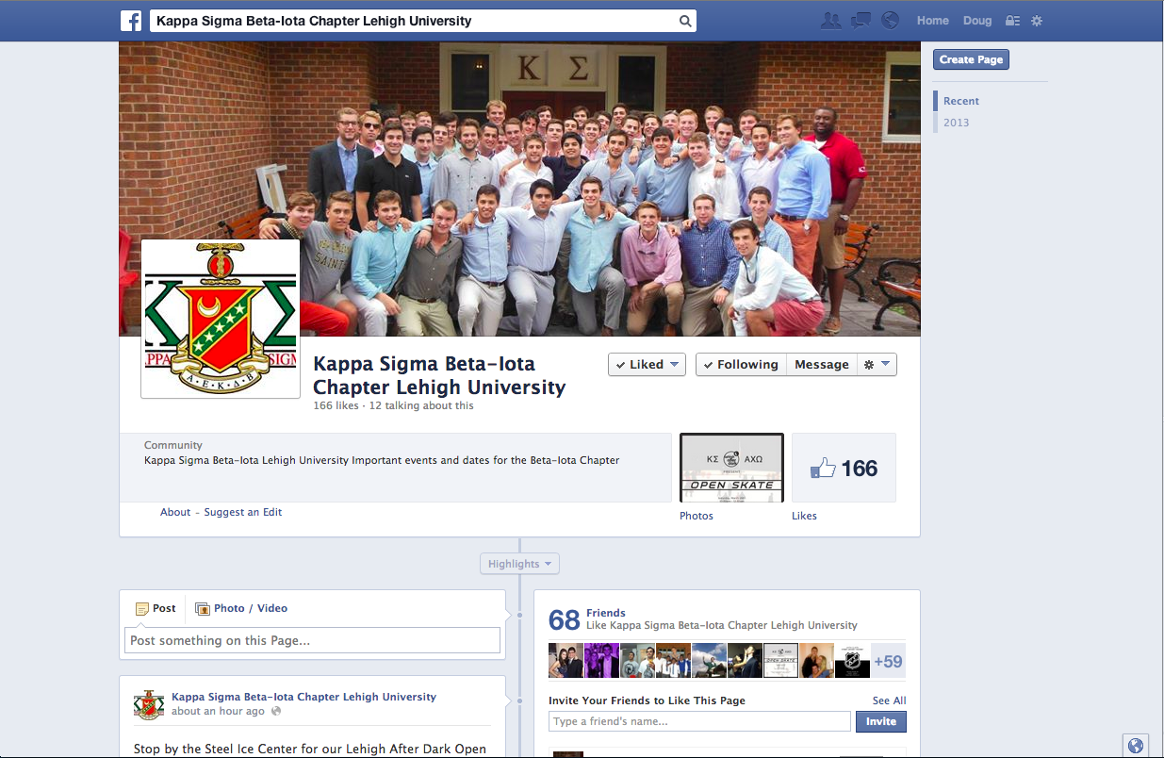

Slide 23
Intellectual Development

Slide 24
Intellectual Development
Taken from kappasigma.org/about/mission/
“The Fraternity should complement and enhance the educational mission of the host institution… The Fraternity should promote academic achievement and assist each member to achieve his academic potential.”

Slide 25
Recommendations from 2012-2013
Create a new Academic Support Program
Partner with the CAS as well as other organizations.
Notes:
Not only Scholastics but All over Intellectual Development

Slide 26
New Member Education- Where We Stood
Last Year=2.39 Pledge Class GPA
Few organized events.
Notes:
Now have more sub committees, getting everyone involved rather than having only leadership chairman or executive committee plan and execute events.
Brothers in Action—adopted new programs based off the suggestions from other chapters in the area as well as the national office.
Guest speakers, resume and interview workshops, conclave

Slide 27
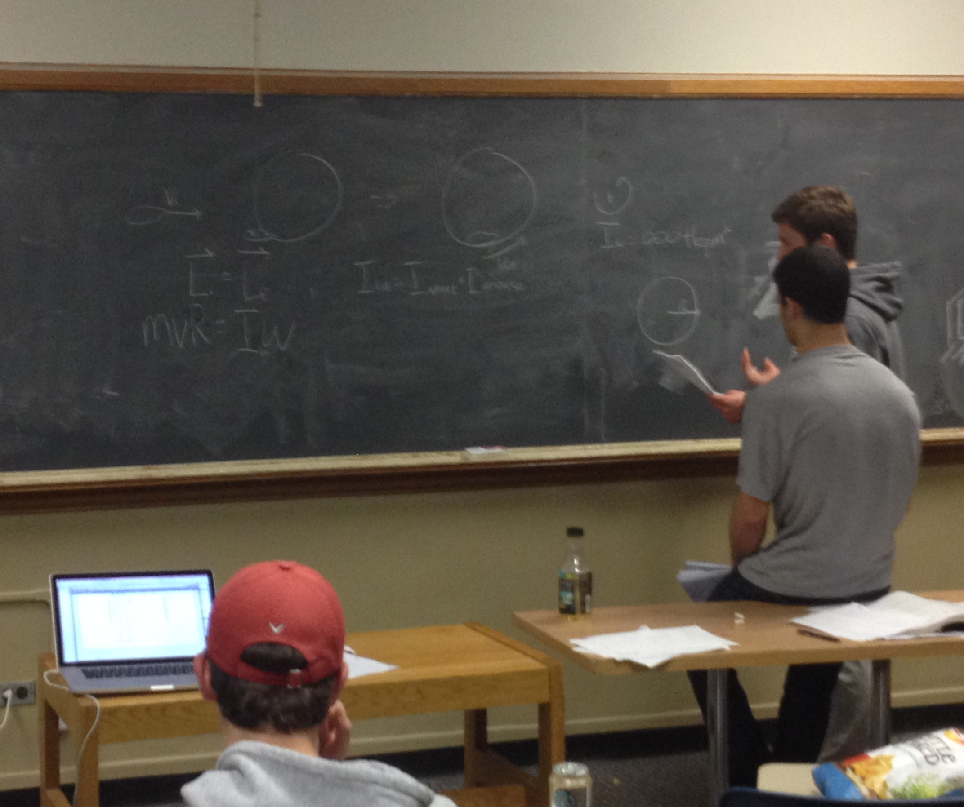
New Member Education- Revisions
Small Group Study Hours
Registration Seminars
Notes:
Now have more sub committees, getting everyone involved rather than having only leadership chairman or executive committee plan and execute events.
Brothers in Action—adopted new programs based off the suggestions from other chapters in the area as well as the national office.
Guest speakers, resume and interview workshops, conclave

Slide 28
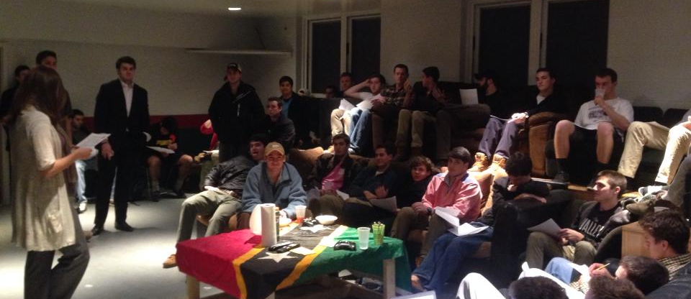
Events with the Center for Academic Success
Study skills and Time Management workshops
One-on-One Walk-in Sessions
Notes:
Now have more sub committees, getting everyone involved rather than having only leadership chairman or executive committee plan and execute events.
Brothers in Action—adopted new programs based off the suggestions from other chapters in the area as well as the national office.
Guest speakers, resume and interview workshops, conclave

Slide 29
Chapter House Revisions
Attendance, Attendance, Attendance
Scholarship Awards
Grade Posting
Culture
Notes:
Now have more sub committees, getting everyone involved rather than having only leadership chairman or executive committee plan and execute events.
Brothers in Action—adopted new programs based off the suggestions from other chapters in the area as well as the national office.
Guest speakers, resume and interview workshops, conclave

Slide 30
Upperclassmen Support Program
Three meeting times throughout the year
Designed to help diagnose what the problem is.

Slide 31
Poverty Simulation
Eye-Opening Experience
Most brothers felt that “the system was against them.”
Notes:
Social Worker was there.
-Bartlett

Slide 32
Looking Forward
Housewide GPA.
Grades aren’t the only thing that matter.
Notes:
New Member Pledge Class Grades
-A lot of programs focused on them
-Lumosity

Slide 33

Leadership Development
Sean Mahony, Leadership Chairman

Slide 34
Leadership Development
Taken from kappasigma.org/about/mission/
“We teach young men social skills that will benefit them throughout their entire lifetime. The multitude of leadership opportunities available through the fraternity prepares members for success in their chosen careers and communities”

Slide 35
Recommendations from 2012-2013
Continue to improve by instituting a more formal and effective leadership development and cultivation program in which all brothers and new members participate in.
Create a larger external presence on campus in leadership roles in clubs and other offices.
Plan and execute leadership events that really matter to us, rather than doing things that do not really pertain to our every-day lives, now or in the future.

Slide 36
Undertaking of “Brothers In Action”
In September we met with Executive Director, Mic Wilson, as well as various other National office liaisons on an effective restructuring of the chapter’s leadership committee, in addition to raising the expectations of each member in their own personal leadership development.
“Brothers in Action”
Notes:
Now have more sub committees, getting everyone involved rather than having only leadership chairman or executive committee plan and execute events.
Brothers in Action—adopted new programs based off the suggestions from other chapters in the area as well as the national office.
Guest speakers, resume and interview workshops, conclave

Slide 37
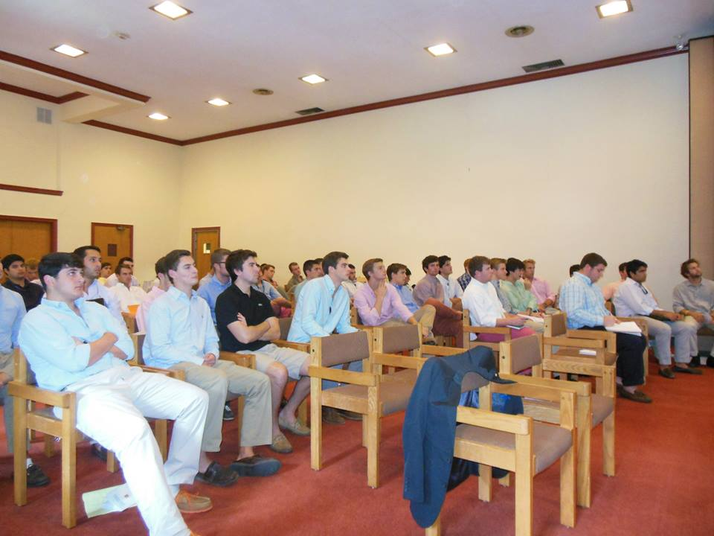

Slide 38

Small group discussions/exercises

Slide 39
Restructuring
Subcommittees within Leadership Development include:
Event planning/coordination (i.e. guest speakers, alumni workshops, ropes course retreats, regional conclave etc.)
New Member Education
Campus involvement and leadershi

Slide 40
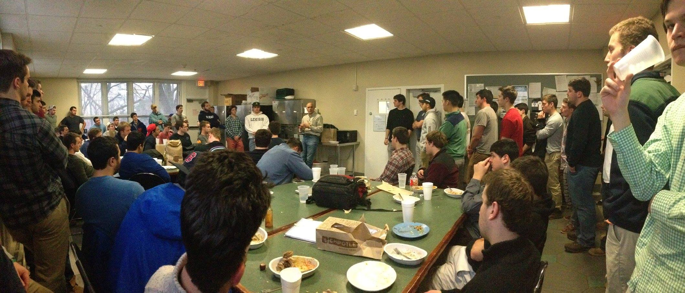
Types of events
Guest Speaker Series
including speakers such as, but not limited to, Lance Drucker—Brother Drucker’s father, and Craig Monaghan, Lehigh graduate ‘80 and ROTC

Slide 41
Types of Events
Beta-Iota Chapter Rewards Program
Each semester each brother pays-in to an account set aside for prizes given to brothers that are voted things such as “Most improved brother, Highest GPA, Most community service, Excellence in Recruitment, and Most helpful, selfless and under recognized brother.
This semester’s awards recipients will be announced and given their prizes at the Father-Son golf outing in April.
Shadowing and Mentorship program
Goes hand in hand with the Scholarship program incorporated to “team-up” new members and underclassmen with older brothers with similar interests, majors, clubs, teams, etc.
“Kappa Sigma Kup”
Weekly Saturday afternoon competitions between floors in the chapter house. New members were added to teams during second semester.

Slide 42
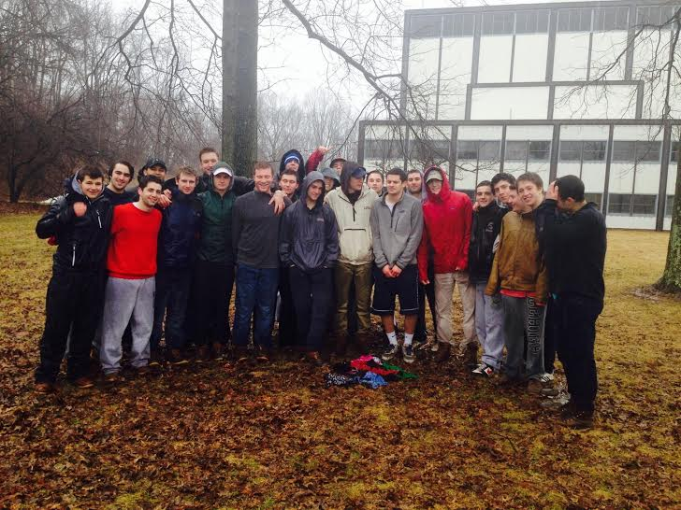
Types of Events
Ropes Course retreat
teambuilding, bonding, and leadership developing exercises and games

Slide 43
Liberty District Regional Conclave
2014 Regional Conclave was held at Lehigh
Subcommittee applied for, was accepted, and began planning the leadership conference starting in October.
Hosted over 200 Kappa Sigma brothers from 12 nearby chapters including 1 colony (Westchester University)
About a dozen guest Speakers came from all over the country including District Grand Master, Christian Nasciemento of Philadelphia, Worthy Grand Procurator, Derek Marchman from Georgia, and Executive Director, Mic Wilson from Virginia.

Slide 44
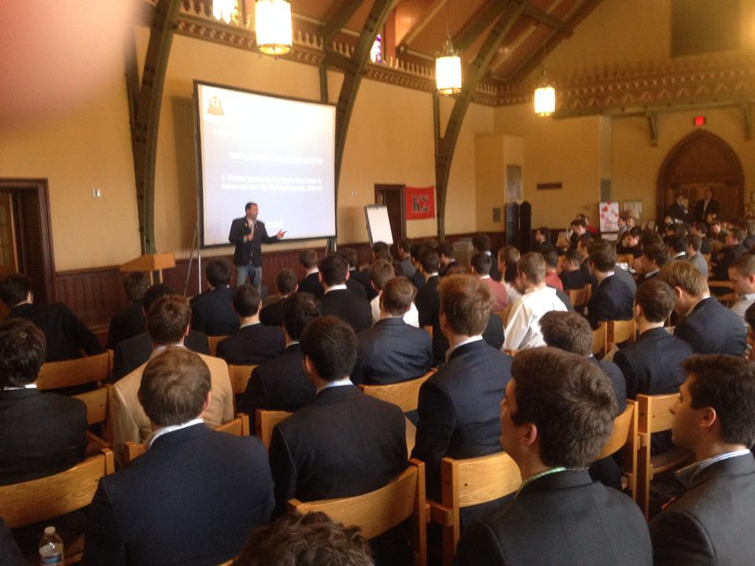
Liberty District Regional Conclave
Topics covered included “How to be a better man”, “A Better Cause”, “What makes a Kappa Sigma a life-long leader?”, “Effective recruiting of the best and brightest” and a Careers seminar, which was ran by prominent Kappa Sigma Alumni speaking about “Do’s and Don’ts” of resumes, cover letters, and interviews.

Slide 45
Campus Involvement
Shortly after we met with Mic Wilson, a new expectation for 100% of brothers to be actively involved in at least one team, club, or office on campus went into effect and was successful.
On top of this goal, our chapter set our sights even higher—striving for at least 15% of brothers to hold some sort of leadership, or elected, roles in their clubs, which is an on-going aspiration.

Slide 46
Campus Involvement: Leadership Roles
Interfraternity Council
Communications Chairman
Greek Emerging Leaders
Brown & White: Lehigh’s student newspaper
Chief Editor (Sports)
Lehigh Friends of Israel
President, and Founder
Institute of Industrial Engineers (IIE)
President
Tamid Israel Investments Club
Founder & VP of Internal Affairs
Utilities Section Leader

Slide 47
Campus Involvement: Leadership Roles
Chabad at Lehigh
Greek Life Coordinator
Business Careers in Entertainment Club
Vice President
Fusion Studio Club
Chief Designer
Division 1 Club-Varsity Ice Hockey Team
Incoming, and Outgoing President and Treasurer
Club-Varsity Ski Team
President
Lehigh Fly Fishing Club
President, and Founders

Slide 48
Moving Forward…
Continue to audit our subcommittees, ensuring that new and effective events and programs are always being planned, and most importantly, executed.
Increase brother’s campus involvement to two or more clubs, and raise the bar to 25% of brothers attempting to, and holding leadership and elected roles around campus.
Spearhead a new concept of teaming up with other chapters, as well as different groups of students on campus in leadership-promoting workshops that will forge better relationships with our community in addition to developing life-long leadership skills.

Slide 49
Facilities Management
AJ Fusco, House Manager
Benjamin Muller, Eco Rep

Slide 50

House Key Management
Due to our lack of responsibility last year with the house key, we decided to implement tile technology on the house keys this year.
This brand new app tracks the tile wherever the key goes throughout the world.
Although we just recently received the technology, we know it is affective and will ensure safety of the key

Slide 51
House Damages and Fines
Last year, Kappa Sigma had over 5,000 dollars in fines and damages.
This year, we had a total of 253.00$ in damages, which reflects an astonishing decrease.
Going Forward: The house looks to continue to decrease damages and increase personal accountability

Slide 52
Life Safety Violations
Through our first three life safety violation inspections, Kappa Sigma has incurred no penalties.
There were also minor or major life safety violations found during our two per year room inspections.
Going Forward: The house looks to continue our success in inspections and increase knowledge house wide about what is expected

Slide 53
Meeting Attendance
Last year, Kappa Sigma missed one on one meetings as well as house manager luncheons.
This year, there was perfect attendance at all house manager functions and meetings.
Going Forward: The house looks to hark on the importance of our house manager making it to all meetings due to the importance of them.

Slide 54
Facilities Management Sub-Committee
The enactment of our sub committee increased the amount of people involved with facilities management.
Now, three brothers were assigned to clean up duty every night.
When there was an issue with the kitchen after break, the committee came together and came up with a comprehensive punishment for the culprit.

Slide 55


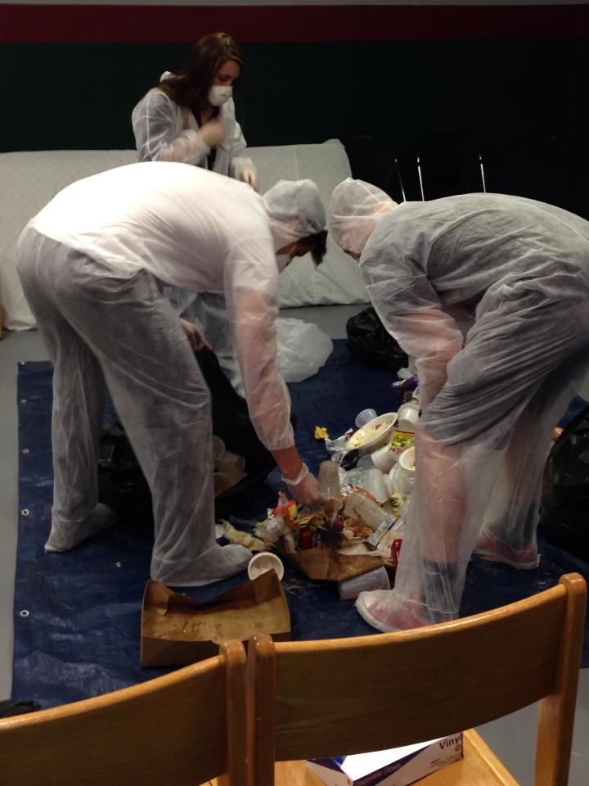

Green Initiative

Slide 56
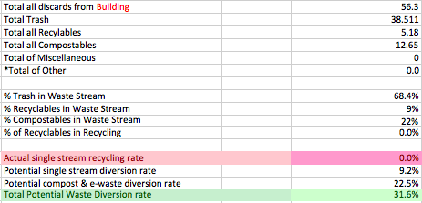

Slide 57
